Slide 1
ELEMENTARY STATISTICS, BLUMAN
Getting Started with the TI Graphing Calculator
© 2019 McGraw-Hill Education. All rights reserved. Authorized only for instructor use in the classroom. No reproduction or further distribution permitted without the prior written consent of McGraw-Hill Education.

Slide 2
Objectives for this PowerPoint
Turn the TI Graphing Calculator on and off
How to clear a list
How to enter a data set into a list
Sort a list

Slide 3
Giraffe Data
142
143
140
147
117
120
140
120
141
144
127
150
127
137
112
The data table to the right contains the birth weights for 15 giraffes. The data are given in pounds.

Slide 4
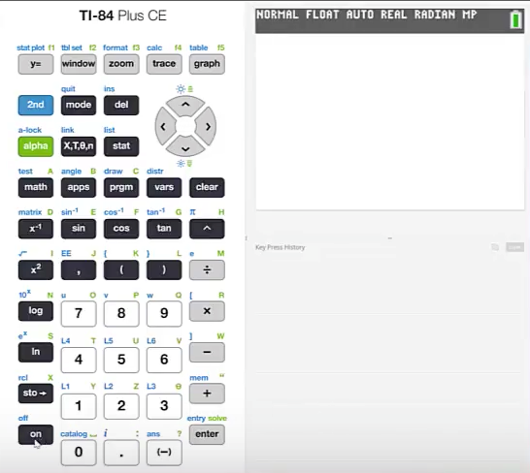
Turn On
In order to turn the TI graphing calculator on press the on button.

Slide 5
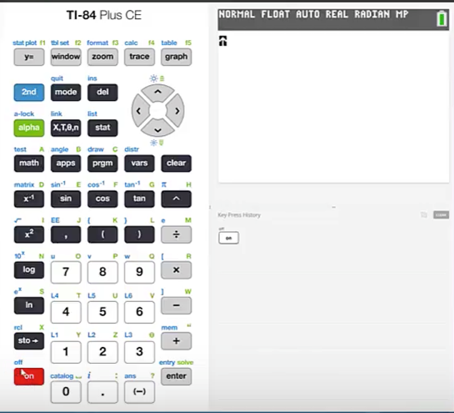
Turn Off
We see that off is printed in blue above the on button.
In order to access the functions that are printed in blue we should first press the 2nd button.
By pressing 2nd and then the on button it will turn the calculator off.

Slide 6
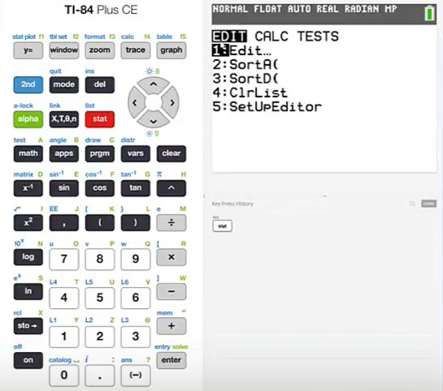
Access a List
To access a list we should first press stat
The first menu in stat is the Edit menu
This is the one that we will use to enter a list. Edit is the first selection and is assigned to the button labeled 1:Edit…
Press 1

Slide 7
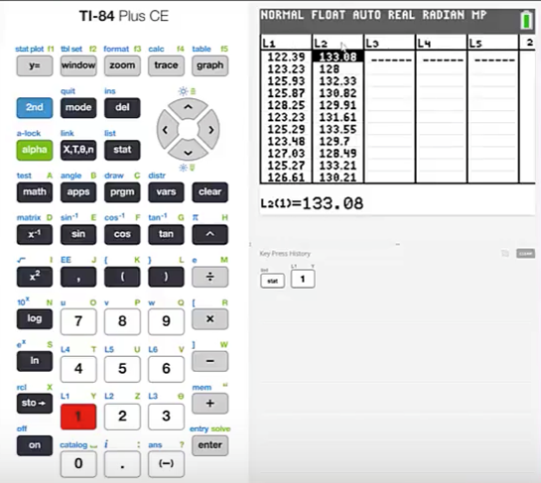
Clear a List (1)
We can see here that there are 5 lists presented. The first 2 lists already contain data.
Let's see how to clear these lists.

Slide 8
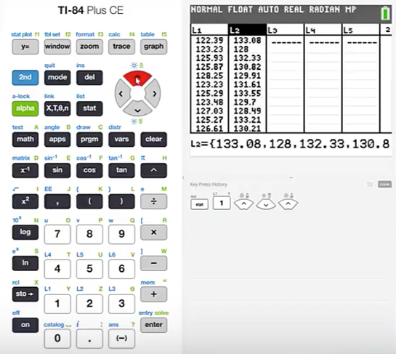
Clear a List (2)
Press the up cursor until a list heading is highlighted.
Press clear
Press enter

Slide 9
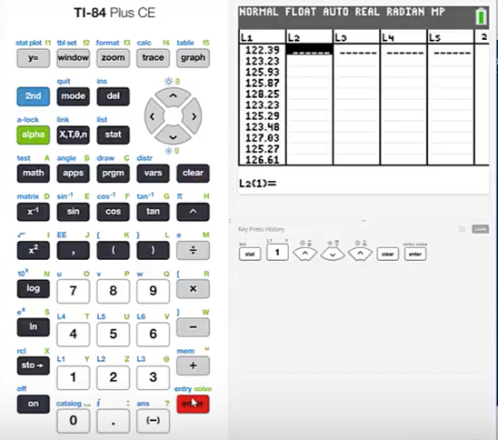
Clear a List (3)
This will clear the entire list.

Slide 10
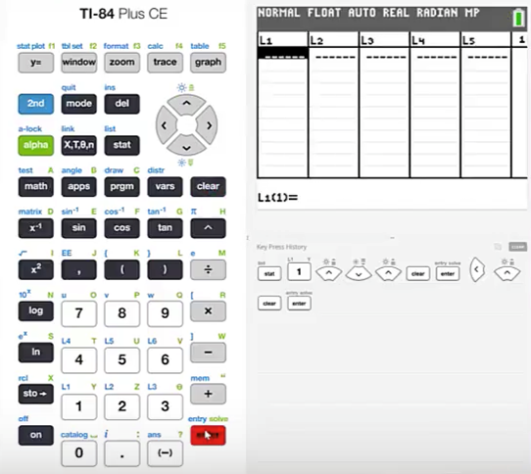
Clear a List (4)
Use the left cursor to highlight the list to the left
Press the up cursor to highlight the heading for List 1
Press clear
Press enter

Slide 11
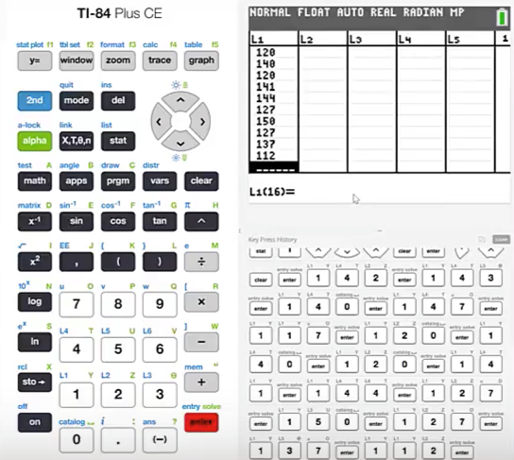
Enter Values in a List
We will now enter the values in the data set for the 15 giraffes.
In order to enter data all we have to do is type in the value.
The first is 142 and then press enter.
This moves the cursor to the next position in the list and then continue to enter all of the data values.

Slide 12
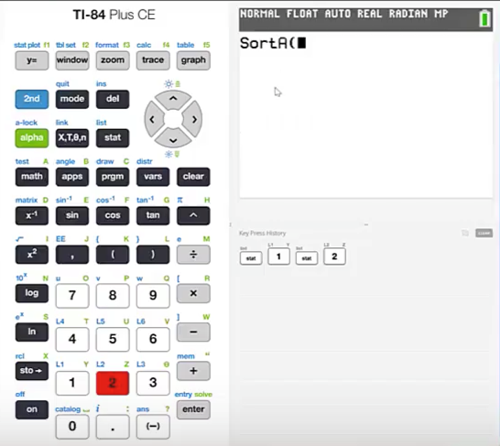
Sort a List (1)
How to Sort a List
In order to sort List 1 we should begin by pressing stat.
The function sort Ascending is assigned to the 2 button. The function sort Descending is assigned to the 3 button. Let's sort the data in an ascending format.
Press 2

Slide 13
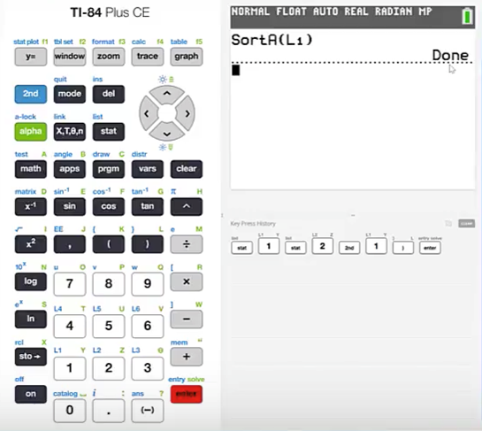
Sort a List (2)
We are prompted to inform the calculator which list should be sorted.
We can see that the blue label above the 1 button is L1 which stands for List 1.
Since it is a 2nd function of the 1 button we'll begin by pressing 2nd and then 1.
Close the parentheses and press enter.
We are notified then that this function is done.

Slide 14
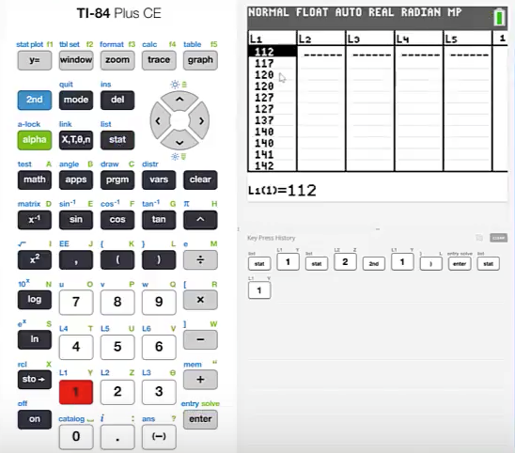
Sort a List (3)
We can see our ascended list by pressing stat and then 1 again for edit.
This data set has been sorted in an ascending format.
By pressing the down cursor we can access each of the entries.

Slide 15
Summary
In this PowerPoint we learned:
How to turn the TI graphing calculator on and off
How to clear a list
How to enter a data set into a list
How to sort a list

